Slide 1
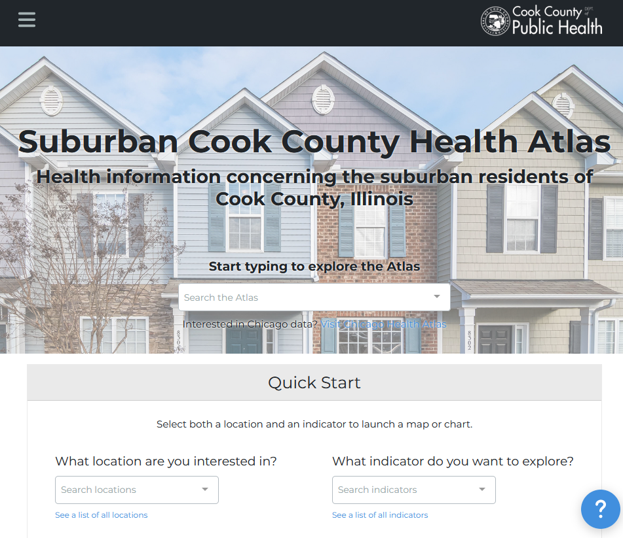
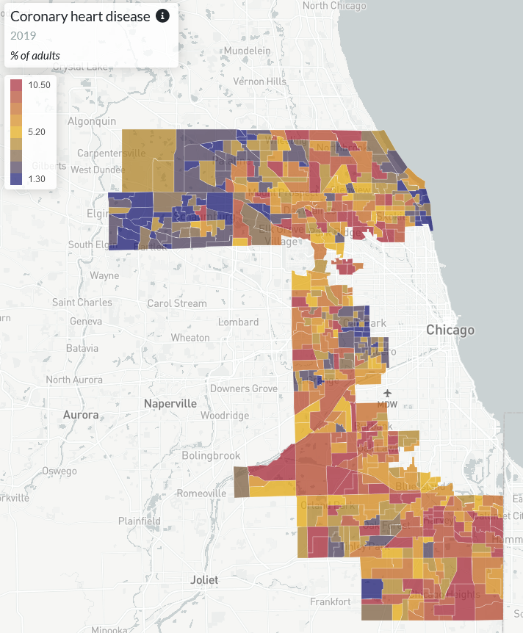


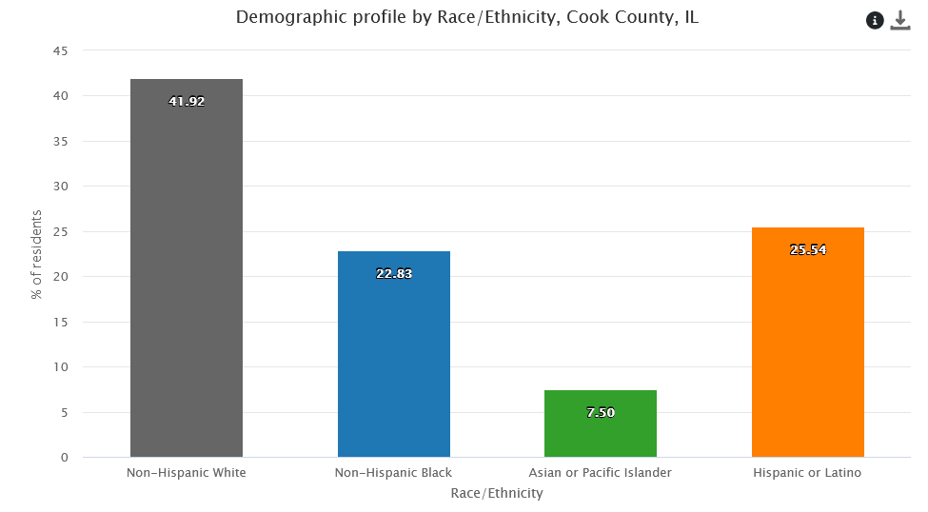
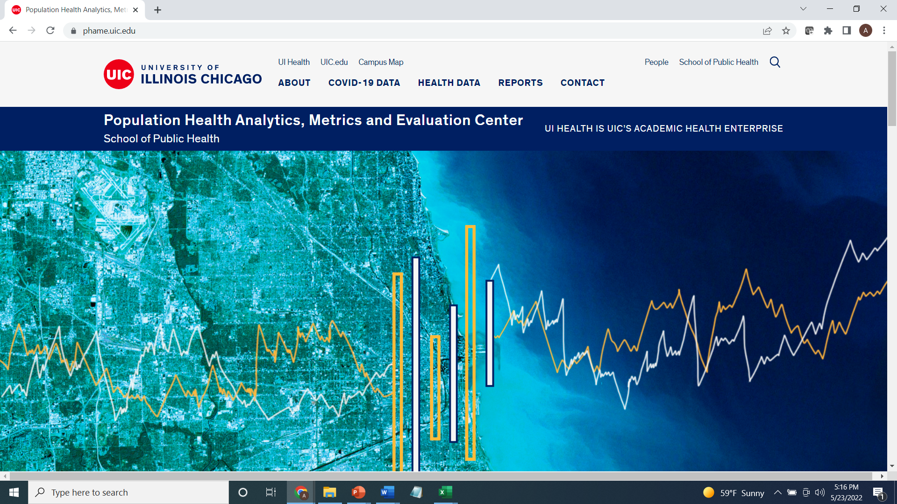
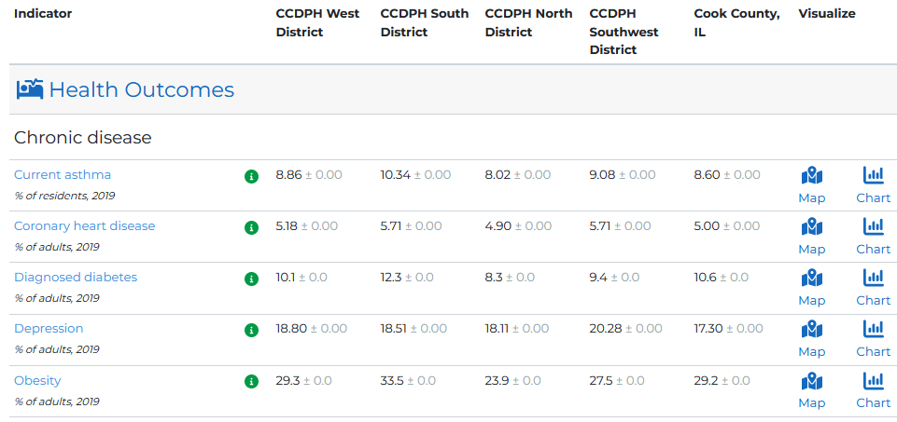
SUBURBAN COOK COUNTY HEALTH ATLAS
Using startup funds from CDC’s Health Equity Grant, CCDPH’s Epidemiology Unit is collaborating with UIC’s PHAME Center and Metopio to design and deploy an online atlas for exploring and sharing health information concerning the suburban residents of Cook County. The atlas allows stakeholders to examine, visualize and download health data using maps, charts and tables.
Notes:
The Cook County Department of Public Health’s Epidemiology Unit is leading an effort to design and deploy an online health atlas for suburban Cook County. We envision the atlas to be a platform for sharing a wealth of information to improve health awareness and decision-making. We are consulting with public health experts, working with other units within the department and reaching out to community members to identify what data to include.
In addition, the atlas contains several quality of life and risk indices related to public health that combine indicators across the six categories (e.g., social vulnerability index, index of concentration of extremes, neighborhood deprivation).

Slide 2


CCDPH PUBLIC HEALTH DATA SHARING ECOSYSTEM
The atlas is an important component of CCDPH’s broader, multi-platform public health awareness, data and code sharing ecosystem.
CCDPH STORYMAPS, DASHBOARDS AND REPORTS
SCC HEALTH ATLAS
Comprehensive, online health indicator data exploration and visualization tools designed for the broadest range of users
Immersive, topic-specific public health information presented using a combination of multimedia content including text and interactive maps
CCDPH GITHUB REPOSITORIES
CCDPH DATA REQUESTS
Delimited datasets, geographic feature layers and associated programming code made available for expert users
Online forms for partner agencies, researchers, community groups and the general public to request custom CCDPH datasets.

Slide 3
HEALTH INDICATOR CATEGORIES
Indicators on the health atlas are organized into six primary categories.
HEALTH OUTCOMES
DEMOGRAPHICS
Consequences, complications and other outcomes that result from disease (e.g., injury, hospitalization, death).
Population characteristics including community size, composition and structure (e.g., population, age, gender, race/ethnicity, migration).
The platform integrates several types of data
HEALTH BEHAVIORS
SOCIOECONOMIC
Individual activities that influence health (e.g., alcohol, drug and tobacco use; diet, physical activity, sleep).
Social and economic factors that can affect health (e.g., income, employment, education, segregation).
HEALTH CARE
PHYSICAL ENVIRONMENT
Systems and services for administering care (e.g., health screenings; primary, prenatal and dental care; clinics, hospitals, FQHCs).
Characteristics of the places where individuals where individuals live, learn, work, and play (e.g., parks, housing, air quality, water quality and transportation)
Notes:
The Cook County Department of Public Health’s Epidemiology Unit is leading an effort to design and deploy an online health atlas for suburban Cook County. We envision the atlas to be a platform for sharing a wealth of information to improve health awareness and decision-making. We are consulting with public health experts, working with other units within the department and reaching out to community members to identify what data to include.
In addition, the atlas contains several quality of life and risk indices related to public health that combine indicators across the six categories (e.g., social vulnerability index, index of concentration of extremes, neighborhood deprivation).

Slide 4
HEALTH INDICATOR SUBCATEGORIES
The six primary categories are further broken down into several subcategories.
HEALTH OUTCOMES
PHYSICAL ENVIRONMENT
HEALTH BEHAVIORS
SOCIO-ECONOMIC
Chronic disease
Infectious disease
Injury and violence
Maternal & child
Community safety
Housing
Transportation
Pollution exposure
Environmental risk
HEALTH CARE
DEMO-GRAPHICS
Income
Education
Employment & occupation
Public assistance
Alcohol & drug use
Tobacco use
Diet & exercise
Sexual activity
Population age
Sex & gender
Race, & ethnicity
Household structure
Language
Migration status
Access to care
Quality of care
Facility utilization

Slide 5
ATLAS Indicator DEVELOPMENT/MAINTENANCE workflow
CCDPH staff will develop and maintain atlas indicators, related code and tables according to standardized workflows.
SOURCE DATA TO ATLAS INDICATOR WORKFLOW
ACQUIRE SOURCE DATA
DATA PROCESSING
INDICATOR DEVELOPMENT
UPLOAD TO ATLAS
Acquire indicator source data of various types using appropriate protocols. Save data documentation, table dictionaries and any import code to SCCHA GitHub repository. Save copy of raw tables to SCCHA database.
Perform cleaning, geocoding and other data quality/control operations. Upload documentation, data dictionaries and processing code to SCCHA GitHub repository. Save copy of processed tables to database.
Aggregate and stratify data by group, year and appropriate geographies. Calculate rates and format indicators in accordance with CCDPH data privacy policy. Save code to GitHub repository and tables in database.
Create indicator placeholder in online atlas along with appropriate metadata. Upload data to atlas, link to indicator. Review download table, map and other visualizations in platform to identify, eliminate any anomalies.
primary
SCCHA GitHub Repo (raw)
SCCHA Databasee (raw)
Clean, geocode and standardize raw data
SCCHA GitHub Repo (form)
SCCHA Databasee (form)
aggregate and stratify count data, calculate rates, format indicators for atlas
SCCHA GitHub Repo (ind)
SCCHA Databasee (ind)
secondary
tertiary
Notes:
Acquire and store raw source data
Acquired data may be of three types:
primary (e.g., health or other survey data collection efforts administered internally by CCDPH);
secondary (e.g., vital statistics, hospitalization records, reportable disease cases/deaths, syndromic, medical examiner, census and other case and/or aggregated information made available from external data provider) ;
tertiary (e.g., SVI, childhood opportunity, EJ screening, pollution monitoring data and other pre-calculated metrics from external data provider)
Collected data may or may not include protected health information (PHI). In some cases, it may be necessary for staff to work with data providers to establish a data use agreement (DUA), collect/submit signatures for data users. All data should include a data dictionary with essential metadata including dataset summary, column names and descriptions, data sources, data year, date information was received/accessed, data contact, etc. Raw data are stored as tables within relational database using a standard naming convention (e.g., name_source_raw_yyyymmdd).

Slide 6
ATLAS Indicator WORKFLOW EXAMPLE
The below figure walks through the steps employed to develop and upload a social vulnerability index set of indicators to the SCCHA.
1
3
New “svi” folder created under SCCHA “data” directory in SCCHA GitHub. Related data acquisition code (svi_raw.R) saved under “scripts” directory. Raw ACS variables stored under data/svi directory and in database.
Processing code developed using standard CCDPH geographies (svi_form.R) saved under “scripts” directory. Formatted indicator variables stored under data/svi directory and in database.
An SVI topic was produced in the SCCHA platform and a unique key developed which was used to create appropriate column headings. Code (svi_ind.R) and data tables saved. It will also be necessary to create additional technical documentation.
SVI data have not yet been uploaded.
2
4
Notes:
Steps
Create an appropriate category for the indicator (if one does not exist)

Slide 7
DATA MANAGEMENT QUESTIONS
Discuss logic of proposed/alternative workflows
With respect to coding, is it worth…
Standardizing code headers to include/communicate key information (e.g., author, updated)?
Agreeing on a standard coding syntax (e.g., variable names)?
Standardizing development/sharing/use of functions across projects/datasets?
Standardizing repo directory structure and file names?
Reaching consensus on what should be included in gitignore?
With respect to data, is it worth
Developing data normalization tests/rules when inputting/importing/modifying data?
Standardizing department geographies and associated field names?

